Slide 1

How computers work? Memory management

Slide 2



How computers work?
Run on ELECTRICITY
Made of circuits/switches

Slide 3


State representation
Off
On

Slide 4

number systems
Base 2 = 2 digits (0, 1)
Binary
Base 8 = 8 digits (0, 1, 2, 3, 4, 5, 6, 7)
Octal
Base 10 = 10 digits (0, 1, 2, 3, 4, 5, 6, 7, 8, 9)
Decimal
Base 16 = 10 digits + 6 Letters (0, 1, 2, 3, 4, 5, 6, 7, 8, 9, A, B, C, D, E, F)
Hexadecimal

Slide 5
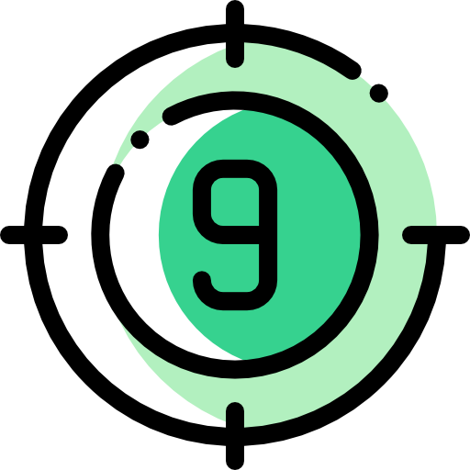
Decimal
human understandable values
$80k/year for a programmer salary
Easy to use and remember
John owes me $50
Easy to perform certain operations ON
21% taxes for $5000 salary = 5000*21/100 = $1050

Slide 6
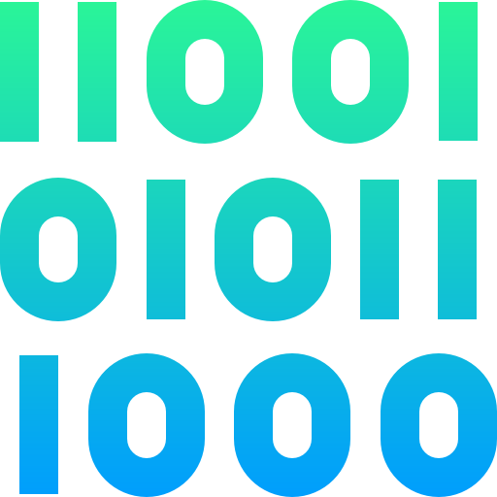
Binary
computer language
Binary = on/off = 0/1 = true/false = state1/state2
= bit
1 byte = 8 bits
117
01110101
=
=
Wtf?
10
2
0
+
1
+
1
+
1
+
0
+
1
+
0
+
1
=
117
*
*
*
*
*
*
*
*
2⁷=128
2⁶=64
2⁵=32
2⁴=16
2³=8
2²=4
2¹=2
2⁰=1
2⁷=128
2⁶=64
2⁵=32
2⁴=16
2³=8
2²=4
2¹=2
2⁰=1
Base
0
1
1
1
0
1
0
1
7
6
5
4
3
2
1
0
1Byte = 8 bits

Slide 7

Hexadecimal
Used to represent big numbers (memory address for example)
2FE
766
/ - division without remainder
25/2 = 12
% - modulo - remainder of division
12*2=24; 25%2 = 25-24 = 1
=
Hex
10
2*16²
+
15*16¹
+
14*16⁰
=
766
2
F
E
766 / 16
=
47
2
766 % 16
=
14
=>
E
47 / 16
=
2
1
47 % 16
=
15
=>
F
2 / 16
=
0
0
2 % 16
=
2
=>
2
=
2FE

Slide 8

Base 10 to base N generalized
n / B
n % B
n - Decimal number
B - Base
,
n = n / B on every iteration
Do this until n / B == 0

Slide 9

Base 10 to base N Example
N = 16
823
N = 2
25
823 / 16
=
51
25 / 2
=
12
2
823 % 16
=
7
=>
7
7
25 % 2
=
1
51 / 16
=
3
12 / 2
=
6
1
51 % 16
=
3
=>
3
6
12 % 2
=
0
3 / 16
=
0
6 / 2
=
3
0
3 % 16
=
3
=>
3
5
6 % 2
=
0
=
337
3 / 2
=
1
4
3 % 2
=
1
1 / 2
=
0
3
1 % 2
=
1
2
0
1
0
0
0
=
00011001

Slide 10
Base N to base 10 generalized
0
n - number of symbols
A - list of symbols ∈ B
B - base
Σ
Ai * B^{|i - (n - 1)|}
,
i = n-1

Slide 11
Base N to base 10 example
N = 16
ABE
14*16⁰
+
11*16¹
+
10*16²
=
2750
N = 2
0110 1010 1010 0111
1*2⁰
+
1*2¹
+
1*2²
+
0*2³
+
0*2⁴
+
1*2⁵
+
0*2⁶
+
1*2⁷
+
0*2⁸
+
1*2⁹
+
0*2¹⁰
+
1*2¹¹
+
0*2¹²
+
1*2¹³
+
1*2¹⁴
+
0*2¹⁵
=
27303

Slide 12
Examples & conversions
10: 115
2: 01110011
16: 73
16:3AB
2: 0000001110101011
10: 939
2: 11110010
16:f2
10: 242
2: 11111111
16:ff
10: 255
16: Abc
2:0000101010111100
10: 2748

Slide 13


Ascii & utf-8 (encoding schemes)
84
1B
Ascii / extended ascii
4B
Utf-8
0-127 = 2^{(8*1 - 1) - 1} - 7 bits
0-4,294,967,295 = 2 ^{(8*4) - 1} - 8 bits
0-255 = 2^{(8*1) - 1} - 8 bits

Slide 14
Encoding & decoding example
Hello
72 69 76 76 79
World!
87 79 82 76 68 33

Slide 15
Examples & conversions
72
H
01001000
228 184 173
中
11100100 10111000 10101101
72 69 76 76 79
Hello
01001000 01000101 01001100 01001100 01001111

Slide 16
Personal encoding (stevenc)
Steve 1 | Steve 2 | Meaning
Hand up | Hand down | Bring bear
Hand down | Hand up | Bring soda
Hand Up | Hand up | Bring bear & soda
Hand down | Hand down | Do not disturb
2^{n} - combinations

Slide 17

Summary
How computers work?
Number systems
encoding schemes

